Slide 1
Homework
Reading Assignment
  Professional Assembly Language, pp 39-59, 62-65
Labs
  Labs will begin on 2/9
  Go To the Lab Section you registered!
Get ready for mp1
  Download the VMWare and tutor VM software from: /nobackup/faculty/cheungr/
  Set up the virtualized SAPC environment using instructions listed in: http://www.cs.umb.edu/~cheungr/cs341/VMWare-for-Tutor_PC_2021.pdf
  or
  http://www.cs.umb.edu/~cheungr/cs341/VMWare-for-Tutor_MAC_2021.pdf

Slide 2
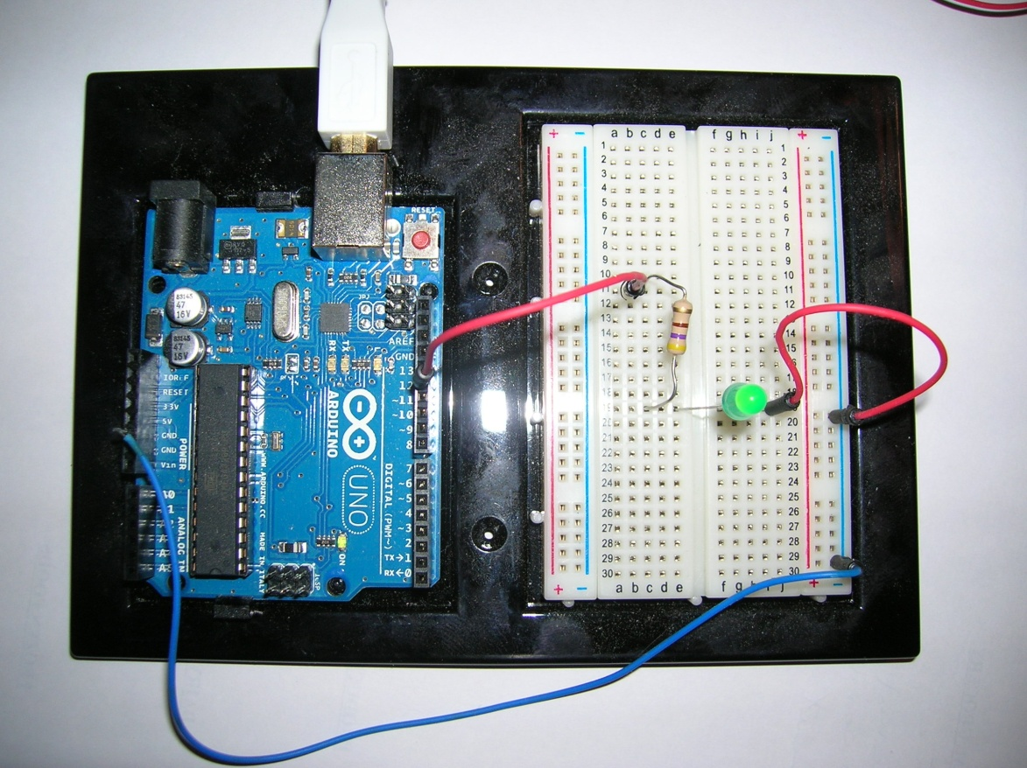
Embedded Systems Lab
Introduction to CS341 lab equipment
Arduino microcomputer system / breadboard

Slide 3
Embedded Systems Lab
Microprocessor – AtMega328P
  8 bit AVR processor @ up to 20 MHz clock
  32 Kbytes program memory plus 1 Kbyte RAM
Programmed using a language like C/C++ with a custom I/O support library
Development system cost $36.00!
Buying the processor alone in quantity would probably be about the price of a candy bar

Slide 4
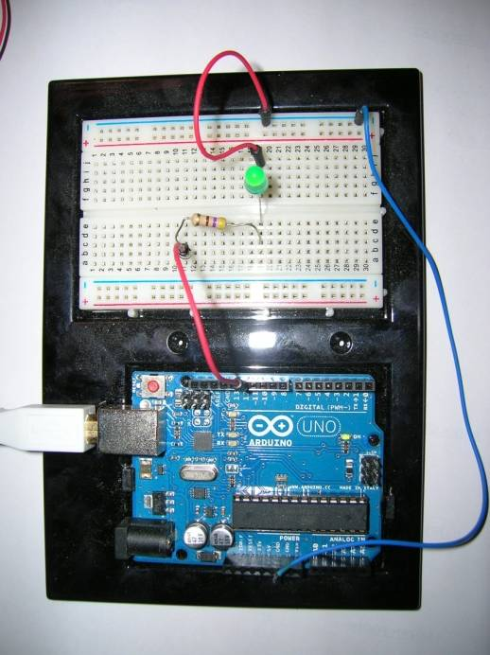
Embedded Systems Lab
To use embedded software development tools, a development host is attached to a target host via:
  RS-232
  Ethernet
  USB
  Other?
Development
Host
PC
USB Cable

Slide 5
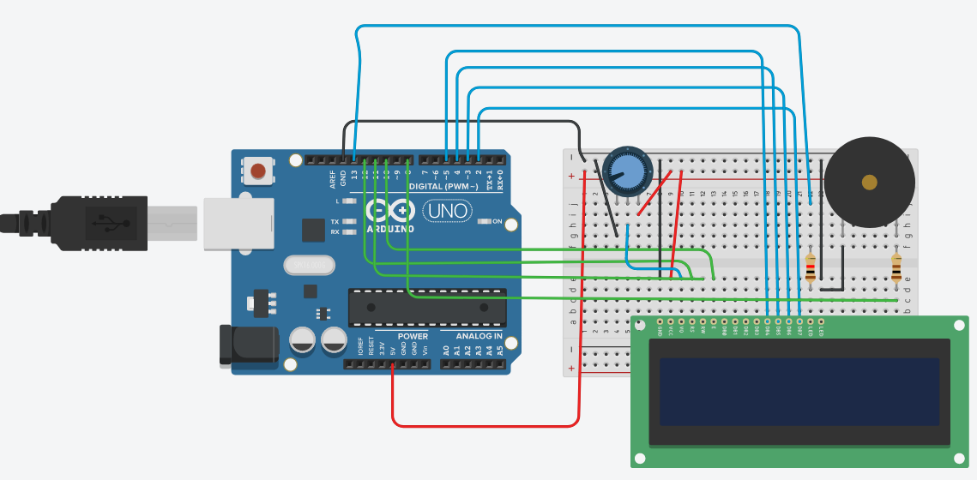
Simulate Lab environment
For this semester, we do not have access to the labs.
We will use a simulated Arduino environment based on tinkercad.com

Slide 6
MP Development Environment
You will also develop C and assembly code for a virtual embedded system on a PC
You will use two VMware virtual machines
  One VM provides a Linux development system
  One VM emulates an embedded system with Tutor
Tutor is just a debug monitor - not really an operating system like Linux
Tutor allows operations prohibited by an O/S

Slide 7
MP Development Environment
PC
users.cs.umb.edu
(LINUX)
SSH
Secure
Link
tutor-vserver
(Linux)
SCP
Your home
directory
and your
cs341 directory
COM1
COM2
tutor
(Tutor)
Virtual Development System
Virtual Embedded System

Slide 8
MP Development Environment
On your PC to connect to UMB server:
  use SSH to login to server users.cs.umb.edu
  copy/edit source files using an editor (vi, nano, emacs)
  compile and/or assemble them using gcc , as
  create tutor executable files using ld
On your PC:
  openVMWare Workstation or VMWare Fusion
  start tutor-vserver and tutor

Slide 9
The “new” Virtualized SAPC Picture
Instructions on how to set up the Virtualized SAPC Environment:
  VMWare Workstation for PCs:
  http://www.cs.umb.edu/~cheungr/VMWare-for-Tutor_PC_2021.pdf
  VMWare Fusion on MACs:
  http://www.cs.umb.edu/~cheungr/cs341/VMWare-for-Tutor_MAC_2021.pdf

Slide 10
MP Development Environment
On tutor-vserver:
  use scp to transfer .lnx files to local Linux
  use mtip to control and monitor the tutor VM
  (Linux prompt>) mtip –f filename.lnx
  . . .
  Tutor>
To download the executable “filename.lnx”
  Tutor> ~d (Wait for “….Done.” Response)
To start running the downloaded program:
  Tutor> go 100100

Slide 11
MP Development Environment
PC
Reset tutor VM
tutor-vserver
tutor
Send ctrl+alt+del
mtip
Tutor
Transparent Relaying of Tutor commands
~q
(Quits mtip)
~d
file.lnx
Memory
You

Slide 12
System Build Processes
The system build processes for C and assembly source courses are driven by our make files
However, it is important to understand how the component build steps work with the SW tools:
    LINUX SW Build Tools
gcc - Compiler to convert C to object
as - Assembler to convert assembly to object
ld - Linker to combine objects to executable nm - Tool to generate symbol tables from objects and
executables
objdump – Dis-assembler to convert executable to assembly

Slide 13
Build Tool for Linux Executable
(run on the linux server)
C Source
Code
Assembly
Code
Object
Code
Executable
File
prog.c
prog.s
prog.o
prog
gcc -S
gcc -c
gcc -o

Slide 14
Build tools for Tutor Executable
(run on the tutor VM)
C Source
Code
Assembly
Code
Object
Code
Executable
File
progc.c
prog.s
prog.o
prog.lnx
gcc -c
as --32
ld

Slide 15
Build tool for Symbol Table Generation
The syms file shows the memory address assigned for each variable or source label
Object
Code
Executable
File
Symbol
File
prog.o
prog.lnx
syms
nm
nm

Slide 16
Setup Test files on LINUX
Copy the directory “examples” from account /nobackup/faculty/examples/ to your cs341 directory using the cp -r command
cd to yours examples/test_dir, you’ll see
  makefile
  test.c
You can build executables for:
  LINUX : using gcc
  Tutor: using make

Slide 17
Example: Test Program Demo
Login to LINUX host users.cs.umb.edu
Compile a program named test.c for running on LINUX
  Produce LINUX executable (test) using gcc
  Run it using ./test
Build a program for running on tutor VM
  Produce tutor executable (test.lnx) using make
  File transfer it to tutor-vserver VM using scp
  Download it to the tutor VM using mtip
  Run it by typing: go 100100

Slide 18
Running the test program for LINUX
Create the LINUX executable “test”
itserver6: gcc –o test test.c
Execute it
itserver6: ./test
Follow the program’s directions. It should finish up quickly and hand control back to LINUX. You will see a LINUX prompt again.

Slide 19
Build the test program for tutor VM
Make the tutor VM executable on itserver6:
itserver6: make C=test
  The suffix “.lnx” is short for Linux, since we are using a Linux-defined executable format
Transfer the test files to the tutor-vserver VM:
  Log into tutor-vserver VM using the credentials provided
  Transfer files from users.cs.umb.edu to tutor-vserver VM:
vserver$ scp username@users.cs.umb.edu:cs341/test/test.* .
Note the space and .

Slide 20
Running the test program on tutor VM (cont’d)
Download the test.lnx file to the tutor VM
  At the tutor-vserver VM, enter
vserver$ mtip -f test.lnx
  After connecting to the tutor VM, you’ll see:
  ….
  Using board #1
  Reboot the tutor VM by selecting the “Send Ctrl+Alt+Del” button at the tutor VM. You’ll see:
  Please type <CR> to confirm console settings:
  Hit <CR> at the vserver VM to get the Tutor prompt. Enter ~d to download the test.lnx file to the tutor VM
  After downloading, Tutor prompt will appear again

Slide 21
Running the test program on tutor VM (cont’d)
To execute the program, type
Tutor> go 100100
Follow the program’s directions. It should finish up quickly and hand control back to Tutor. You will see Tutor prompt again.
You can run it again by issuing command “go 100100”
Type “~q” or two ctrl-Cs to quit out of mtip

Slide 22
More mtip Commands
The ESCAPE CHARACTER: ~ This is the escape character that MUST precede ALL COMMANDS. (if you need to change it, use the -e argument to mtip)
The Most Important Commands: (uppercase or lowercase: ~Q or ~q for quit, etc.)
~h - Help. Will display all commands possible.
~q - quit mtip back to LINUX.
~d - This command will download the file argued in the command line by the -f.
~f - This command will allow you to specify the download file from inside mtip (same effect as -f on command line)
~\char - Send one char to board "as is”
~! - This will allow you to issue a LINUX command to a subshell.

